Slide 1


Credit Card Fraud Detection System
Mentor:
Muvendiran M
Team Members:
Vishal Tyagi Dhanush
Suhas Rkithik
Prasanth Kumar Prateek Mishra
Vidhita Tutu

Slide 2
Introduction
Problem Statement
Dataset Description
Credit card fraud detection is crucial for safeguarding financial transactions. This project focuses on analyzing a dataset to identify fraudulent transactions within a highly imbalanced distribution.
The dataset encompasses transactions made by European cardholders in September 2013. It contains over 284,000 transactions, including 492 fraudulent cases, representing a very small proportion of the data.

Slide 3
Dataset Overview
Key Attributes
Class Imbalance
The dataset includes features like transaction time, amount, and principal components derived from PCA. The "Class" variable indicates whether a transaction is fraudulent or not.
Fraudulent transactions constitute only 0.172% of the dataset, posing a significant challenge for model training and evaluation.

Slide 4

Data Preprocessing
1
Handling Missing Values
2
Feature Scaling
RobustScaler was employed to scale features, mitigating the impact of outliers.
No missing values were detected in the dataset.
3
Addressing Class Imbalance
4
Feature Analysis
A correlation heatmap was used to identify relationships between features and their potential impact on model performance.
The Synthetic Minority Oversampling Technique (SMOTE) was used to balance the class distribution by generating synthetic samples.

Slide 5
Models Trained
Logistic Regression
Decision Tree
Random Forest
A linear model that estimates the probability of fraud based on input features.
A tree-based model that uses a series of rules to classify transactions as fraudulent or not.
An ensemble model that combines multiple decision trees to improve prediction accuracy.
XGBoost
Support Vector Machine
LightGBM
A gradient boosting algorithm known for its high performance and ability to handle complex datasets.
A powerful model that creates a hyperplane to separate fraudulent from non-fraudulent transactions.
A gradient boosting algorithm that focuses on speed and efficiency, making it suitable for large datasets.
CatBoost
Another gradient boosting algorithm that excels in handling categorical features and reducing overfitting.

Slide 6
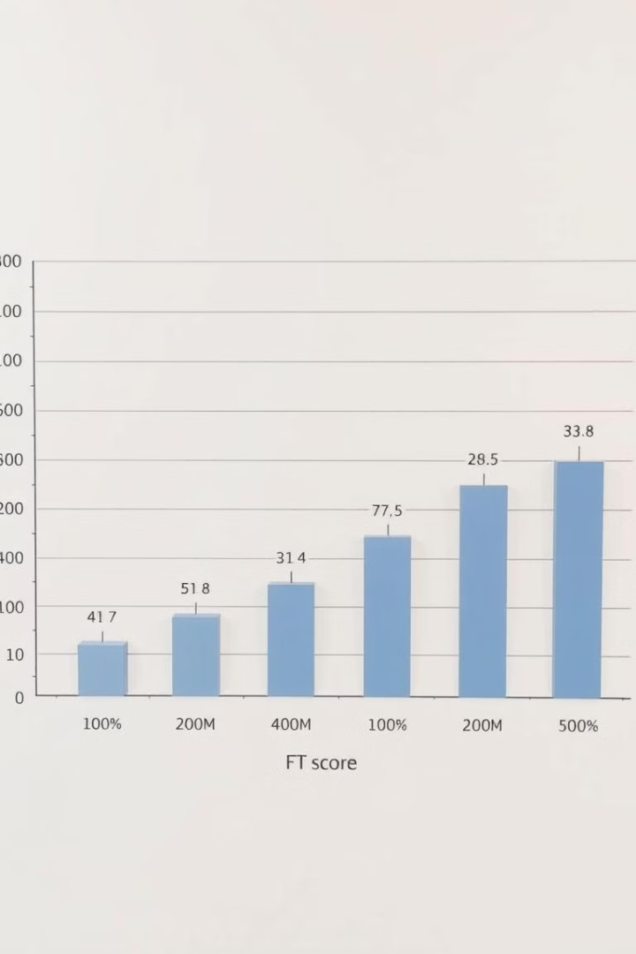
Results Comparison
Model
Accuracy
F1-Score
ROC-AUC
Logistic Regression
99.91%
81.25%
97.52%
Decision Tree
99.89%
78.45%
96.34%
Random Forest
99.95%
85.67%
97.89%
XGBoost
99.96%
87.83%
98.40%
Support Vector Machine
99.93%
83.33%
97.65%
LightGBM
99.94%
86.98%
98.21%
CatBoost
99.95%
87.02%
98.18%

Slide 7
Best Performing Model
XGBoost
Key Metrics
XGBoost emerged as the best-performing model, achieving the highest accuracy, F1-Score, and ROC-AUC scores.
Accuracy: 99.96% ROC-AUC: 98.40% F1-Score: 87.83%

Slide 8

Key Insights
SMOTE Impact
Model Performance
Threshold Tuning
The use of SMOTE was crucial for handling the class imbalance and improving model performance.
XGBoost outperformed other models, while Random Forest showed high precision but lower recall.
Fine-tuning the decision threshold can optimize the trade-off between precision and recall.

Slide 9




Challenges and Limitations
Data Imbalance
Computational Cost
Precision-Recall Trade-off
The imbalanced dataset presented a significant challenge for model training and evaluation.
Some models, like XGBoost and SVM, CatBoost, required substantial computational resources, particularly for larger datasets.
The choice of model often involved balancing the trade-off between precision and recall, depending on the specific goals.

Slide 10
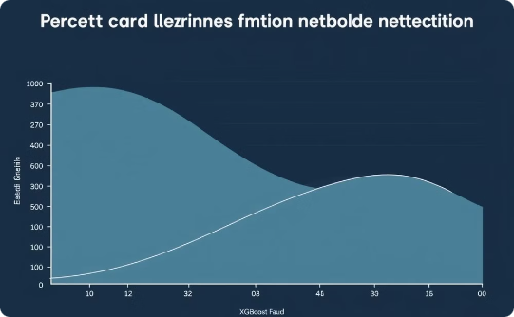


Conclusion
XGBoost's Superior Performance
High Accuracy Achieved
Acknowledgments
Effectively identifies fraudulent transactions.
Thanks to Infosys Springboard for this opportunity.
Our analysis shows XGBoost is superior.

